Slide 1
Objects advanced bits

Slide 2
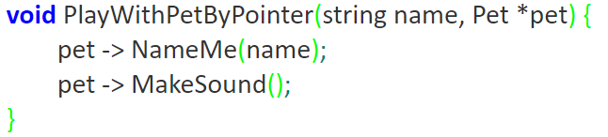
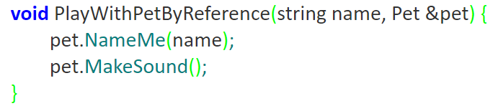
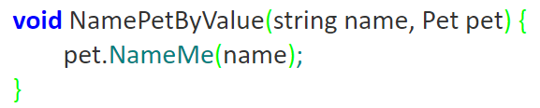
Objects as parameters
By pointer
By reference
By value

Slide 3
Pointer or reference or value?
http://www.cplusplus.com/articles/z6vU7k9E/
https://www.educba.com/c-plus-plus-reference-vs-pointer/
Pass by value when the function does not want to modify the parameter and the value is easy to copy
Pass by const pointer when the value is expensive to copy AND the function does not want to modify the value pointed to
Pass by non-const pointer when the value is expensive to copy AND the function wants to modify the value pointed to
Pass by const reference when the value is expensive to copy AND the function does not want to modify the value referred to
Pass by reference when the value is expensive to copy AND the function wants to modify the value referred to
The reasons for each is probably not needed for the exam, you will need to know the differences thought

Slide 4
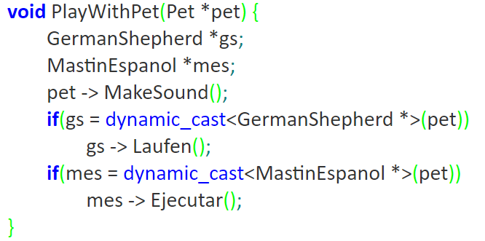
I was taught that this is smelly code

Slide 5

http://cppblogs.blogspot.com/2013/08/c-style-casts.html
#include <iostream>
using namespace std;
class shape{public :virtual ~shape(){}};
class circle:public shape{};
class square:public shape{};
int main(int argc, char* argv[])
{
shape *b = new circle; //Upcasting
square* s = dynamic_cast<square*> (b);//downcasting to incorrect type
(s!=NULL)?cout<<"Right cast"<<endl:cout<<"Wrong cast"<<endl;
circle *c = dynamic_cast<circle*> (b);//downcasting to correct type
(c!=NULL)?cout<<"Right cast"<<endl:cout<<"Wrong cast"<<endl;
return 0;
}

Slide 6
Copy constructor
Default copy constructor does a shallow copy (pointers point to same items)
User defined will do a deep copy
Copy constructor vs assignment operator?

Slide 7
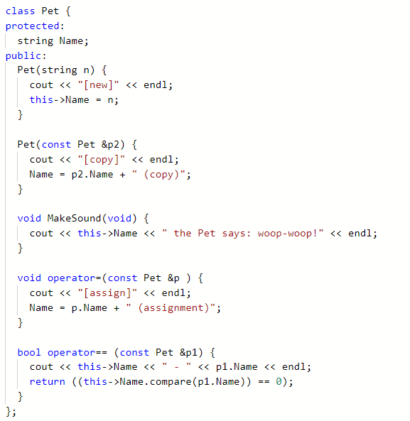
Construct
Copy
Assign
Equality

Slide 8
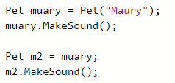


Slide 9


Copy constructor is called when a new object is created from an existing object, as a copy of the existing object. And assignment operator is called when an already initialized object is assigned a new value from another existing object.

Slide 10




Slide 11



Slide 12
Const and friend
Const – read only
Friend – access private methods and values
Cpp institute does a great job explaining both of these

Slide 13
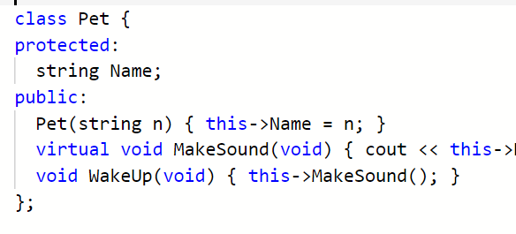
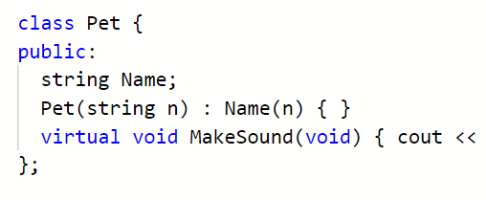
Member initialization

Slide 14
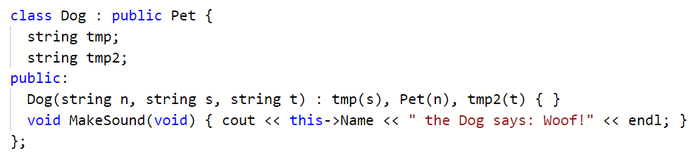

Slide 15
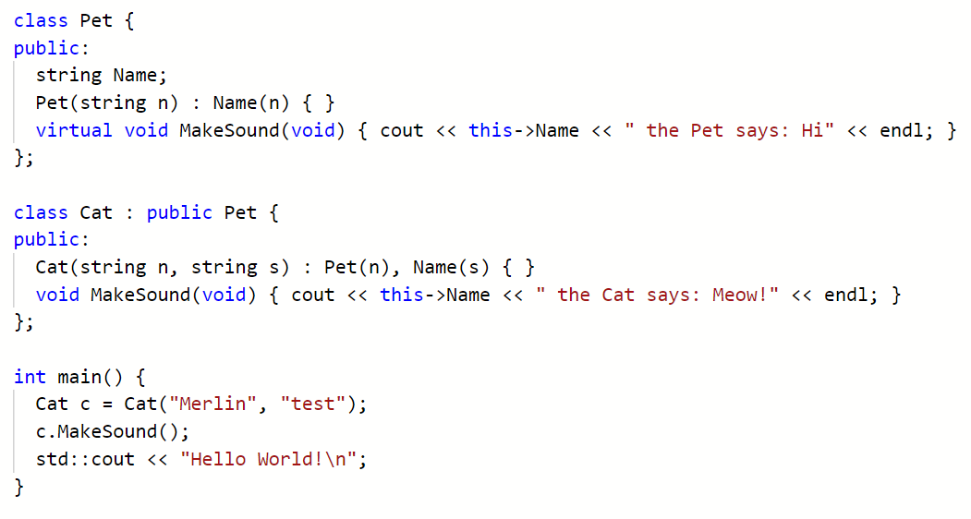
https://repl.it/@JohnGlazebrook/c-classes-3-inheritance-6

Slide 16
Name is not a member of Cat, only of Pet, so Cat can not initialize it

Slide 17
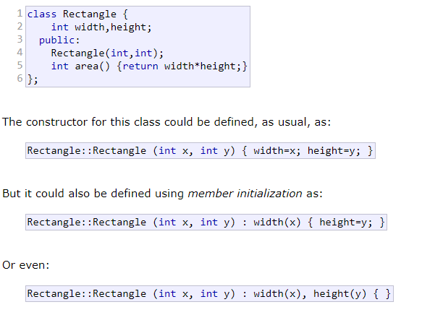
Member initialization in constructors
http://www.cplusplus.com/doc/tutorial/classes/
https://www.geeksforgeeks.org/when-do-we-use-initializer-list-in-c/

